Slide 1
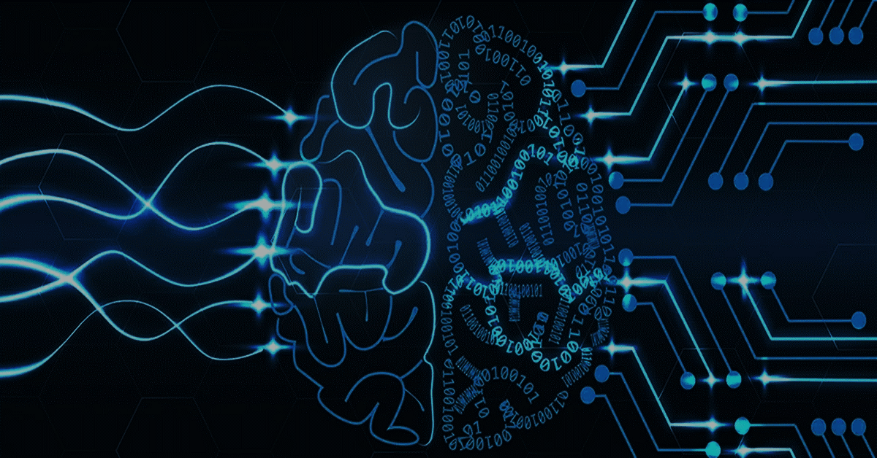
NEURAL NETWORKS:
HOW MACHINES LEARN LIKE OUR BRAIN

Slide 2
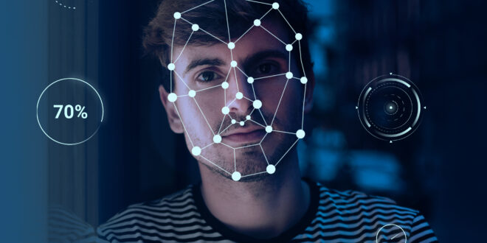
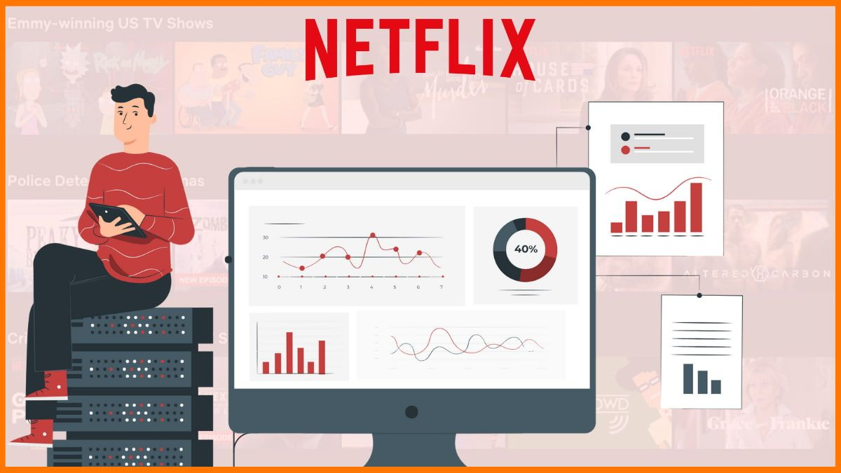
How it Works
FACE RECOGNITION
Image Acquisition & Detection:
Feature Extraction (The CNN Magic)
Face Print Generation (Data Conversion):
Matching & Identification
NETFLIX RECOMMENDATION
Data Collection
Deep Learning Models
Recommendation Generation
Personalization

Slide 3
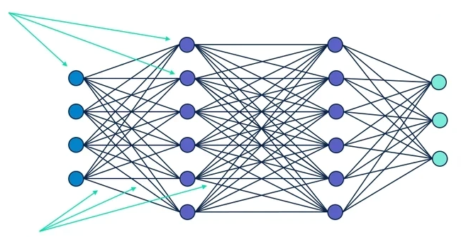
WORKING PROCESS
Input
Layer
Hidden
Layer 1
Hidden Layer 2
Output
Layer
Neurons
Variable 1
Class 1
Variable 2
Class 2
Variable 3
Class 3
Variable 4
Connections
Direction of data

Slide 4
USES
Computer
Vision
Speech Recognition
Health
&
Medicine
Robotics
Science
&
Research
Automation
Finance
Gaming
&
Entertainment
Natural Language
Processing

